Slide 1
NY CitiBike Challenge
File created on: 2/3/21 7:12:22 PM EST

Slide 2
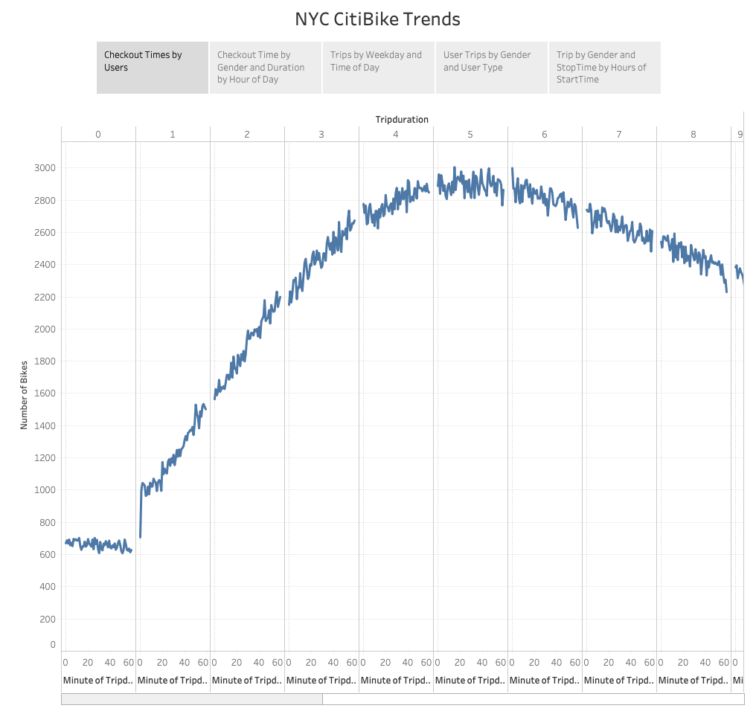

Slide 3
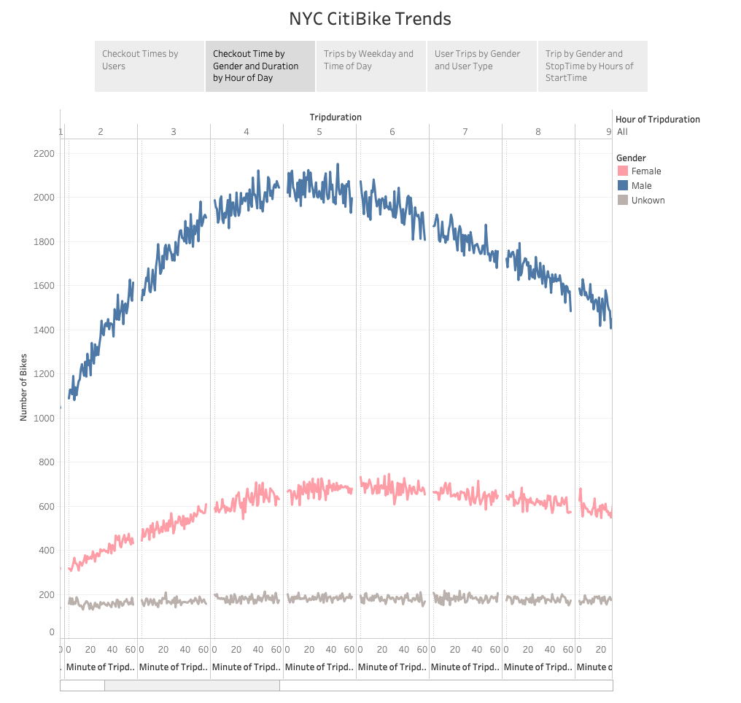

Slide 4
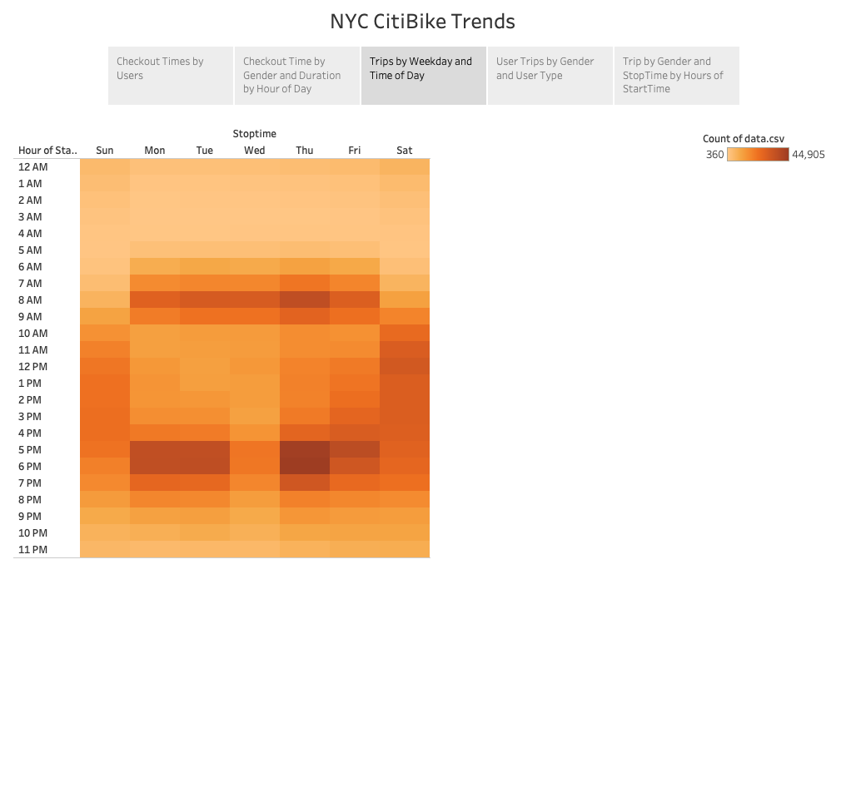

Slide 5
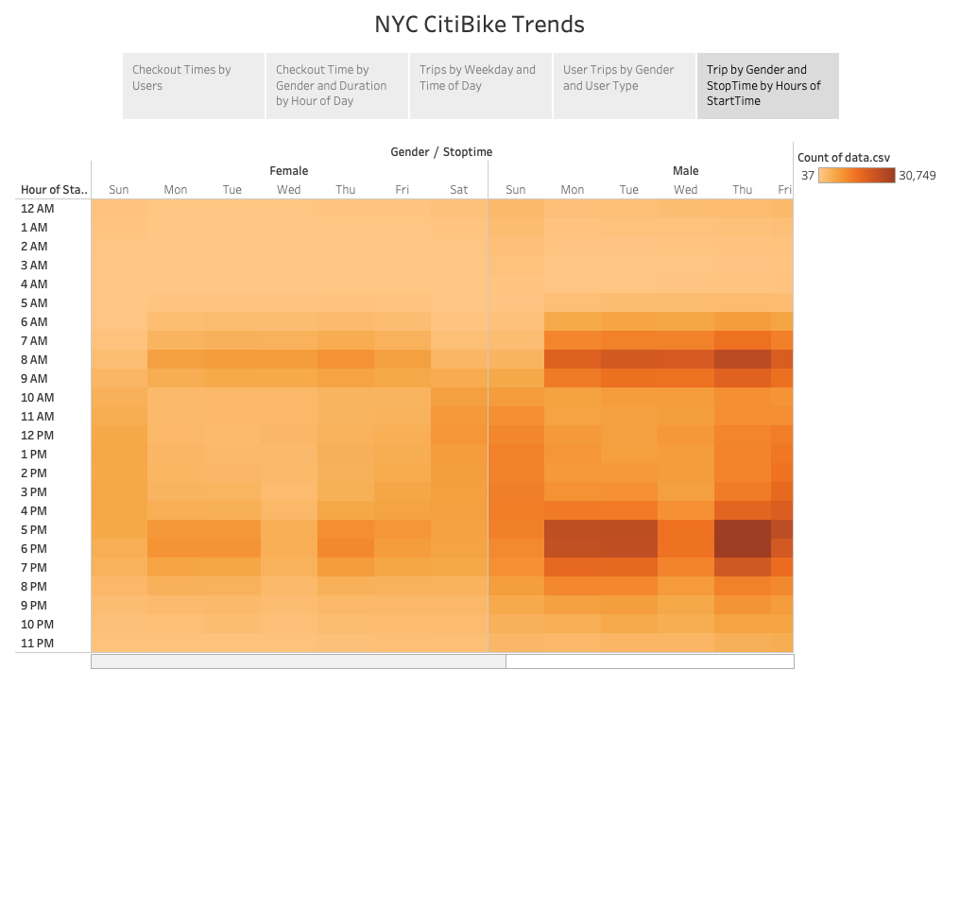

Slide 6
